Slide 1
Mathematical Foundations of Computer Science
UNIT -I

Slide 2
Mathematical Foundations of Computer Science
Fundamental concepts and tools in discreet mathematics with emphasis on their applications to computer science.
Topics include logic and Boolean circuits; sets, functions, relations, databases, and finite automata: deterministic algorithms, recurrence equations, trees and more general graphs.
Computer science is the art of solving problems with computers.
At end of the course, the students should be able to formulate logic expressions for a variety of applications.

Slide 3
Introduction of Set theory
A Set is an unordered collection of objects, known as elements or members of the set. An element ‘a’ belong to a set A can be written as
‘a ∈ A’, ‘a ∉ A’ denotes that a is not an element of the set A.
Representation of a Set A set can be represented by various methods. 3 common methods used for representing set: 1. Statement form. 2. Roaster form or tabular form method. 3. Set Builder method.

Slide 4
Statement form In this representation, the well-defined description of the elements of the set is given. Below are some examples. 1. The set of all even number less than 10. 2. The set of the number less than 10 and more than 1.
Roster form In this representation, elements are listed within the pair of brackets {} and are separated by commas. Below are two examples.
1. Let N is the set of natural numbers less than 5. N = { 1 , 2 , 3, 4 }.
2. The set of all vowels in the English alphabet. V = { a , e , i , o , u }.
Set builder form In Set-builder set is described by a property that its member must satisfy. 1. {x : x is even number divisible by 6 and less than 100}. 2. {x : x is natural number less than 10}.

Slide 5
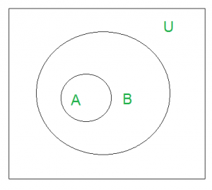
Equal sets Two sets are said to be equal if both have same elements. For example A = {1, 3, 9, 7} and B = {3, 1, 7, 9} are equal sets.
Subset
A set A is said to be subset of another set B if and only if every element of set A is also a part of other set B. Denoted by ‘⊆‘. ‘A ⊆ B ‘ denotes A is a subset of B.
‘U’ denotes the universal set. Above Venn Diagram shows that A is a subset of B.

Slide 6
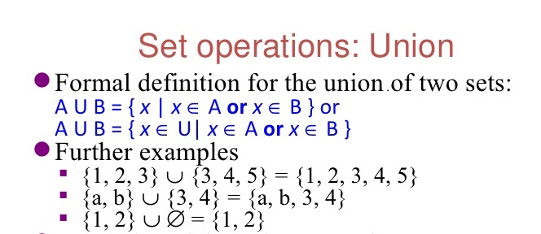
Set operations : UNION
Definition: Let A and B be sets. The union of A and B, denoted by A ⋃ B, is the set that contains those elements that are either in A or in B, or in both.

Slide 7
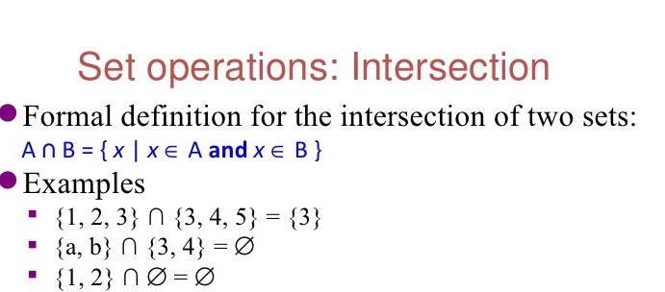
Set operations : INTERSECTION
Definition: Let A and B be sets. The intersection of A and B, denoted by A ⋂ B, is the set that contains those elements that are in both A and B.

Slide 8
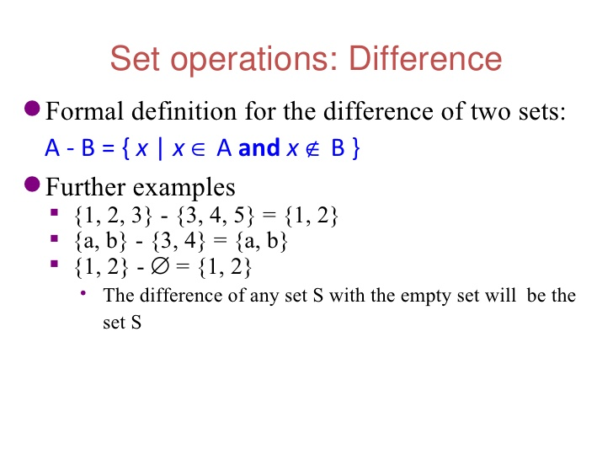
Set difference
Definition: Let A and B be sets. The difference of A and B, denoted by A - B, is the set containing those elements that are in A but not in B. The difference of A and B is also called the complement of B with respect to A.

Slide 9
Special sets
The universal set is denoted by U: the set of all objects under the consideration.
The empty set is denoted as or { }.

Slide 10
Mathematical Logic
Georage Boole first introduced the axiomatic approach to logic and it is sometimes called Boolean logic or mathematical logic or symbolic logic. Symbolic logic is now increasingly used in the study of language of a computer.
Sentence are classified as
Declarative
Exclamatory
Interrogative
Imperative

Slide 11
Statements and notations:
A proposition or statement is a declarative sentence that is either true or false (but not both).
For instance, the following are propositions:
“ Paris is in France”(true),
“London is in Denmark”(false),
“2 < 4” (true),
“4 = 7” (false).
However the following are not propositions:
“what is your name?” (this is a question),
“do your homework” (this is a command),
“this sentence is false” (neither true nor false),
“x is an even number” (it depends on what x represents),

Slide 12
Truth table: Display the relationship between truth values of propositions.
Example: p: Delhi is the capital of India.(T).
q : Delhi is the capital of Andhra Pradesh.(F)
P | Q
T | F

Slide 13
Connectives
The logical operators given below are called connectives. The logical operators are
AND(∧)
OR( ∨)
IF…THEN(⇒)
IF AND ONLY IF(⇔)
NOT(~)

Slide 14
Logical Connectives.
P∧Q is read “P and Q,” and called a conjunction.
P∨Q is read “P or Q,” and called a disjunction.
P→Q is read “if P then Q,” and called an implication or conditional.
P↔Q is read “P if and only if Q,” and called a biconditional.
¬P is read “not P,” and called a negation.
Truth Conditions for Connectives.
P∧Q is true when both P and Q are true
P∨Q is true when P or Q or both are true.
P→Q is true when P is false or Q is true or both.
P↔Q is true when P and Q are both true, or both false.
¬P is true when P is false.

Slide 15
Conjunction
The conjunction of two statements p and q is the statement p∧q which is read as p and q.
the statement p∧q has the truth value “T” whenever both p and q have the truth value “T”
otherwise it has the truth value “F” conjunction is defined by table.
Example: Translate the following statement into symbolic form.
P: RAM went to hotel.
Q: SHYAM went to hotel.
RAM and SHYAM went to hotel.
P | Q | P∧Q
T | T | T
T | F | F
F | T | F
F | F | F

Slide 16
disjunction
The disjunction of two statements p and q is the statement p∨q,
which is read as p or q. If the truth-value of even one out of p and q is true then that of p∨q is true,
Otherwise the truth-value of p∨q is false. The disjunction is defined by below table.
Example: Obtain the truth value of the disjunction of “the earth is flat” and “3+5=8”
Solution: let p : the earth is flat
q : 3+5=8
We know that p is false and q is true. Therefore, the truth-value of p∨q is true.
P | Q | P∨Q
T | T | T
T | F | T
F | T | T
F | F | F

Slide 17
Negation
The negation of a preposition p is not p denoted by ‘~p’.
If the truth value of p is true then the truth value of ~p is false.
Also if the truth-value of p is false these truth-value of ~p is true. The truth table of ~ is given below.
Example: consider the statement
p: Dolly is at study center.
~p : Dolly is not at study center
p | ~p
T | F
F | T

Slide 18
Conditional Connective
Given any two propositions p and q we denote the statement ‘if p then q’ by p→q. we read this as p implies q
The statement p→q has a truth value F when q has the truth value F and p the truth-value ‘T’; otherwise it has truth value T. The conditional is defined in below table.
P | Q | P→Q
T | T | T
T | F | F
F | T | T
F | F | T

Slide 19
Biconditional
Let p and q be two propositions. The compound statement
(P→q) ∧ (q→p)is the biconditional of p and q.
We denote it by p↔q, and read it as ‘p if only if q’. We also say that ‘p is necessary and sufficient for q’. The statement p↔q has the truth value T whenever both p and q have identical truth-values. The biconditional table is given below.
P | Q | P→Q | Q→P | P↔Q
T | T | T | T | T
T | F | F | T | F
F | T | T | F | F
F | F | T | T | T

Slide 20
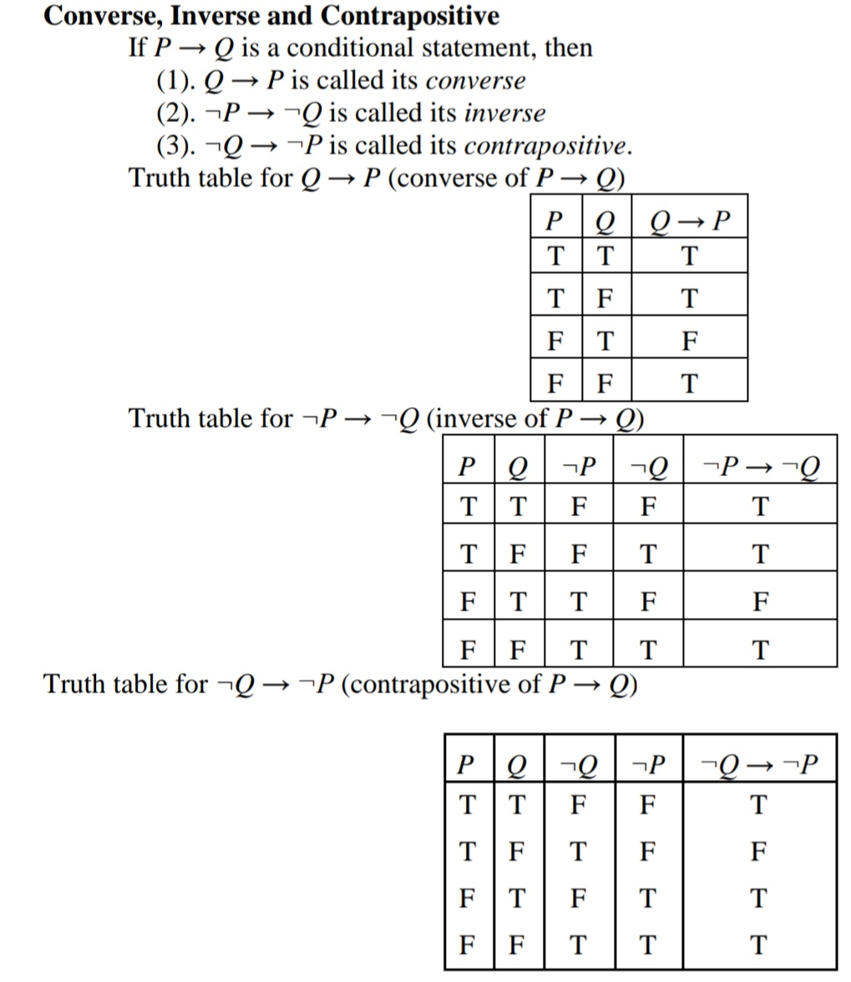

Slide 21
Well-Formed Formula (WFF)
“A statement formula is an expression which is a string consisting of variables parenthesis, and connective symbols”.
A string called a formula if it has the following properties:
A statement variable standing alone is a well-formed formula.
If p is a formula, the ~p is also a formula.
If p and q are formulas then p∧q, p∨q, p→q and p↔q are formulas.
A string of symbols containing the statement variables, connectives and parenthesis is a well-formed formula, iff it can be obtained by finitely many applications of the rules 1,2 and 3.
A formula is also called well-formed formula and denoted by wff.

Slide 22
Example:
According the definition of the following wffs.
~(p∧q), (p→(p∨q)), (p→ (q→r)).
The following are not wffs
1. ~p∧q clearly ~p, q are well formed formulas. A wff would by either (~p∧q)or ~(p∧q)
2. (p→q) → ( ∧q). This is not a wff because ∧q is not.

Slide 23
Tautologies
A statement that is true for all possible values of its prepositional variables is called a tautology.
A statement that is always false is called a contradiction.
A statement that can be either true or false, depending on the truth-values of its prepositional variables is called a contingency.

Slide 24
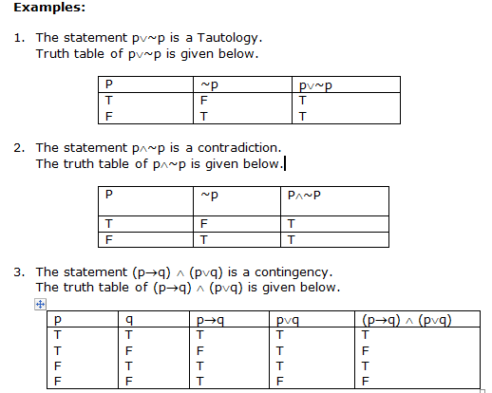

Slide 25
Equivalence Of Formulae (Logical Equivalence)
Two statement formulae A and B in variables p₁,p₂…..p_{n}(n1) are said to be equivalent if they acquire the same truth values for all interpretations i.e., they have identical truth values.
Therefore the statement formulas A and B are equivalent provided A↔B is a tautology and conversely if A↔B is a tautology, then A and B are equivalent.
We shall represent the equivalence of two formulas, says A and B, writing “A⇔B”, which is read “A is equivalent to B”.

Slide 26
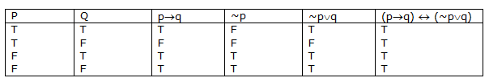
Prove (p→q)⇔(~p∨q) (law of implication) Solution: We prove this by truth table.

Slide 27

Prove that ~ (p∨q) ≅ (~p) ∧(~q) (Demorgan law) Solution:

Slide 28
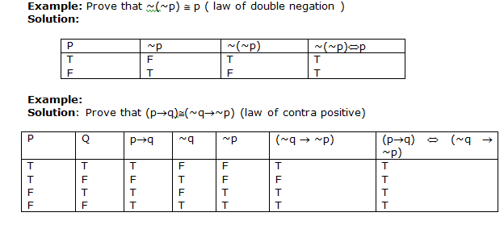

Slide 29
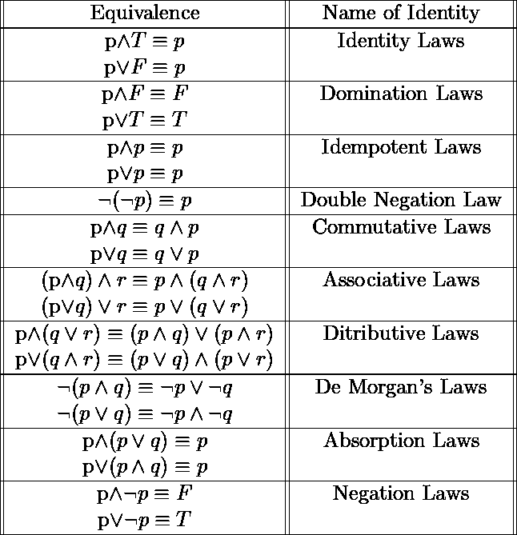
Important Equivalences

Slide 30
Duality Law
Two formulas A and A* are said to be duals of each other if
either one can be obtained from the other by replacing
∧ and ∨ and ∨ by ∧.
The two connectives are called dual to each other.
If the formula A contains the special variables T or F,
then its dual A* is obtained by replacing T by F and F by T
in addition to the change suggested above.
Example :
The dual of (p∨q)∧ r is (p∧q)∨r
The dual of ~(p∨q) ∧ (p∨~(q∧~s))
~(p∧q)∨(p∧~(q∨~s))

Slide 31
Normal Forms
In a formula, a product of variables and their negations is called an elementary product.
Similarly a sum of the variable and their negations is called an elementary sum. Let P and Q be any two variables.
Then p, ~P∧Q, ~Q∧P∧~P, P∧~P and Q∧~P are some examples of elementary products. P, ~P∨Q, ~Q∨P∨~P, P∨~P and Q∨~P are some examples of elementary sum of two variables.
1. An elementary product is identically false iff it contains at least one pair of factors which one is the negation of the other.
2. An elementary sum is identically true iff it contains at least one pair of actors in which one is the negation of the other

Slide 32
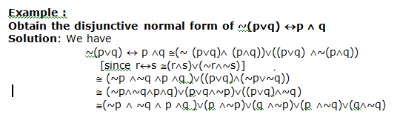
Disjunctive Normal Forms (DNF)
A formula which is equivalent to a given formula and which consists of a sum of elementary product is called a disjunctive normal form of the given formula.
Given formula is identically false if every elementary product appearing in its DNF is identically false.

Slide 33
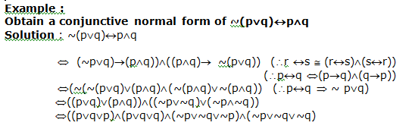
Conjunctive Normal Forms (CNF)
A formula, which is consists of a product of elementary sums and is equivalent to a given formula is called a conjunctive normal forms of the given formula.

Slide 34
Principal Disjunctive Normal Forms
For two statement variables P and Q, construct all possible formulas, which consists of conjunctions of P or its negation and conjunctions of q or its negation such that none of the formulas contain both a variable and its negation. Note that any formula which is obtained by commuting the formulas in the conjunction should not be included in this list because any such formula will be equivalent to one included in the list. For example, any one of p∧q or q∧p is included in the list, but not the both. For two variables p and q, there are 4 formulas included in the list; these are given by
p∧q, p ∧ ~q, ~p∧q, ~p ∧ q

Slide 35
Principal Conjunctive Normal Form
Given a number of variables, maxterm of these variables is a formula, which consists of disjunctions in which each variable or its negations, but not both, appear only once. Also the maxterms are duals of min. terms. For a given formula, an equivalent formula consisting of conjunctions of the maxterms only is known as its principal conjunctive normal form or the product of sums of canonical terms.
The principal conjunctive normal form for A is
(~p∨~q∨r)∧(~p∨q∨~r)∧(~p∨q∨r)∧(p∨~q∨r)∧(p∨q∨~r)

Slide 36
First-order logic
First-order logic—also known as predicate logic, quantificational logic, and first-order predicate calculus—is a collection of formal systems used in
Mathematics , philosophy, and computer science.
First-order logic uses quantified variables over non-logical objects and allows the use of sentences that contain variables, so that rather than propositions such as Socrates is a man one can have expressions in the form "there exists x such that x is Socrates and x is a man" and there exists is a quantifier while x is a variable.
This distinguishes it from propositional logic, which does not use quantifiers or relations; in this sense, propositional logic is the foundation of first-order logic.

Slide 37
First order predicate logic
In first-order logic, a predicate can only refer to a single subject. First-order logic is also known as first-order predicate calculus or first-order functional calculus. A sentence in first-order logic is written in the form Px or P(x), where P is the predicate and x is the subject, represented as a variable.

Slide 38
Methods of proof
Direct Proof
Indirect Proof
Proof of Contradiction
Proof of Exhaustion

Slide 39
Rules of Inference
The following are two important rules of inferences.
Rule P: A premise may be introduced at any point in the derivation.
Rule T: A formula S may be introduced in a derivation if S is tautologically implied by one or more of the preceding formulas in the derivation.

Slide 40
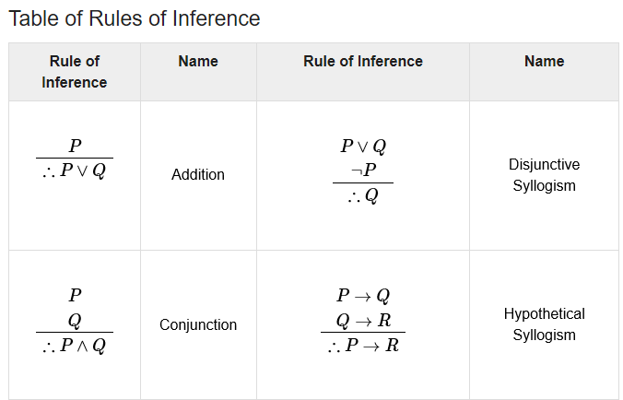

Slide 41
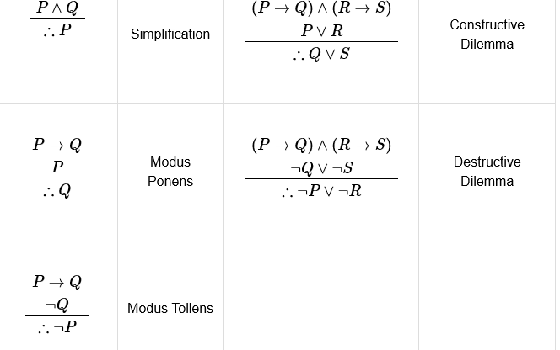

Slide 42

Theory of Inference for the Predicated Calculus
The following four rules describe when the universal and existential quantifiers can be added to or deleted from an assertion.
Rule 1: Universal specifications (us) : if a statement of the form ∀x, p(x) is assumed to be true, then the universal quantifier can be dropped to obtain p (c ) is true for an arbitrary object c in the universe. This rule may be represented as

Slide 43

Rule 2 : Universal Generalisation (UG) : if a statement p (c ) is true for each element c of the universe, then the universal quantifier may be prefixed to obtain ∀x,p(x). in symbols this rule is

Slide 44


Rule 3 : Existential specification (ES) : if ∃x,p(x) is assumed to be true, then there is an element c in the universe such that p (c) is true. Symbolically.
Rule 4 : Existential Generalization (EG) : if p (c ) is true for some element c in the universe, then ∃x, p(x) is true in symbols, we have

Slide 45
Automatic Theorem Proving
A proof of a proposition C is a mathematical argument consisting of a sequence of statements A_{1,} A_{2………}A_{m} form which C logically follows. So C is the conclusion of this argument. The statement that is proved to be true is called a theorem. Sometimes it happens that we feel a certain statement is true, but he doesn’t succeed in proving it. It may also happen that we can’t disprove it. Such statements are called conjecture.
For every n>2, n ∈ N, If n is even, then n is sum of two primes. To this day, no one has been able to prove it or disprove it.

Slide 46
Variables: The capital letters of English alphabets A, B, C,…….P, Q, R….. will be used to denote the statement variables.
Connectives: The connectives ~, ∧,∨,→, ↔ appear in the formulas with the order of precedence as given above
String of Formulas : A string of formulas is defined as follows :
any formula is a string of formulas.
If α and are strings of formulas, than α, β and β, α are strings formulas,
Only those strings which are obtained from steps ( i ) and ( ii ) are strings of formulas.

